Slide 1

Project Proposal
GoMingle
Social Dining & Restaurant Booking Platform
Discover Restaurants. Secure Tables. Create Memories.
NUCES MS PRACTICUM | September 2026 | Prepared by: Team GoMingle

Slide 2
The Problem
A structural gap in the Karachi Food & Beverage sector
2,600+
5–20%
100%
Licensed restaurants in Karachi alone — fragmented, no unified discovery
Karachi restaurant no-show rate on reservations made by phone & WhatsApp
Of no-show cost absorbed by the restaurant — zero accountability mechanism
THE COMPLICATION
Diners lack a trusted, social-first platform that combines curated discovery, group coordination, and verified post-dining reviews.
Restaurants have no mechanism to enforce booking commitments — and the cost of no-shows, at an average cover of PKR 2500–4000, runs into hundreds of millions of PKR annually.

Slide 3
What We're Building
Core flow: discover → book → secure with card → dine → review
WHAT THEY'RE ACHIEVING
01
Mingler App
Flutter
Booking commitment
A PayFast pre-auth hold is placed at booking and captured at the 24-hour confirmation trigger no-show penalties follow in Phase 2.
Platform fee
Post-dining in-app payment splits to the restaurant after an admin-configured platform commission on every confirmed booking.
Verified review
Reviews unlock only after a booking reaches Completed status. A corpus that is structurally impossible to fake.
Phase 2 data foundation
Every booking, arrival and review feeds the dataset required for AI analytics and dynamic pricing.
7 features · 30 sub-features — auth, payments, discovery, interest tables, reviews, notifications, loyalty
02
Restaurant Web Portal
React.js , NestJS
4 features · 9 sub-features — restaurant profile, table availability, booking view, revenue reports
03
Admin Panel
React.js , NestJS
5 features · 11 sub-features — onboarding, users, finance, loyalty config, interest table management

Slide 4
Delivery Timeline
42 weeks end-to-end, structured in three phases with clear milestone gates
Specs Sign-Off
Staging Checkpoint
QA Complete
Finalization
Post Support
M1
M2
M3
M4
M5
PHASE 1
PHASE 2
PHASE 3
Requirements & Specs
Development
Regression, UAT Deployment
W1 – W11 · 11 weeks
W12 – W32 · 21 weeks
W33 – W42 · 10 weeks
Requirements looping · Feature specs & sign-off · UI/UX Figma design & sign-off · System & API architecture · AWS CDK infrastructure stacks · Sprint 0 — CI/CD pipeline setup
AWS infrastructure (RDS · Redis · OpenSearch) · NestJS modular monolith — all 6 modules · PayFast/Safepay pre-auth lifecycle & NoShowOrchestrator · Flutter Mingler App (iOS + Android) · Partner Web Portal and Admin Panel (React.js) · interim staging checkpoint at W20
Full regression cycle · OWASP security scan via Snyk · Client UAT (W36–W38) · Production deploy — AWS UAE Region (me-central-1) · Hypercare & 30-day post deployment checks (W40–W42)

Slide 5
Development Strategy
A specs-first build process, accelerated by AI-native engineering practices
01
02
03
Specs-First Build
Hybrid Mobile App
Phase-Gated Delivery
Traceability Matrix · Sign-Off
Flutter · iOS + Android
Hybrid Agile · PMI Phase-Gates
A front-loaded 11-week specification phase locks 3 products, 16 features and 50 sub-features. UI/UX Figma designs and API contracts are formally signed off before a single line of production code is written.
A single Flutter codebase delivers the Mingler App native-feel performance, with Dart strong-typing reducing runtime errors.
Iterative and adaptive execution with weekly client status calls, structured sprint cycles and five formal milestone gates every phase transition clears a documented quality gate before the next begins.
Specs-first + AI-augmented delivery keeps the 42-week delivery timeline predictable.

Slide 6
AI-Augmented Design & QA
Claude and AI-augmented tooling accelerate design, front-end delivery and quality assurance
01
02
03
Portal Design with Claude
Mobile Design & Codegen
QA Automation with Claude
Claude · UI/UX
AI Codegen · Flutter
Claude · Test Automation
Claude designs and iterates the Restaurant Web Portal and Admin Panel UI/UX — faster cycles, one consistent design language.
AI-assisted codegen tooling generates mobile UI design and Flutter front-end code for the Mingler App, speeding up the build phase.
Claude supports test case generation across all three products, widening regression coverage.
AI tooling accelerates delivery — the GoMingle team owns final quality.

Slide 7
Technical Foundation
Cloud-native, secure-by-design architecture underpinning the MVP
01
02
03
Cloud-Native Infrastructure
Modern Data & Integration
Security &
Compliance
AWS ECS Fargate · Asian Region
PostgreSQL · Redis · Elasticsearch
OWASP · Snyk · PCI-DSS via PayFast/Safepay
Container-first NestJS modular monolith on ECS Fargate, no cold starts, deployed in AWS me-central-1.
Managed RDS PostgreSQL, Redis for locking and queues, and Elasticsearch for discovery — behind Cognito auth and an ALB.
OWASP Top 10 scanning via Snyk in CI/CD, AES-256 encryption at rest, TLS 1.3 in transit — no card data stored on GoMingle infra.
Full architecture, integration design and tech stack rationale in Section 3 of the Technical Proposal.

Slide 8
Key Dependencies
Client-side inputs required to hold the 42-week timeline
PayFast/Safepay & Payments
AWS Account Access
Production PayFast/Safepay API keys, with payouts enabled for restaurant partners. All payments processed in PKR.
A dedicated GoMingle AWS account with IAM access. All production stores are provisioned in me-central-1 (UAE) with full data residency.
Sign-Off Authority
Restaurant Partners
A GoMingle PO empowered to approve specs, designs and UAT specs frozen at W11, UAT sign-off by W38 alongside the NUCES Practicum Supervisor for academic gate approval.
At least 5 restaurant partner profiles provided by GoMingle for UAT testing and readiness.
Third-Party Accounts
ProMingler Pool
Twilio WhatsApp, SendGrid, Firebase FCM, Google Maps Places, Open Loyalty, before submission.
Around 50 hand-picked ProMinglers onboarded internally for Phase 1 — admins promote Mingler accounts into the approved pool that Interest Table creation draws from.
Any slippage on these inputs directly impacts the 42-week end-to-end delivery window.

Slide 9
Assumptions
Defined assumptions used for estimation, resource planning, and delivery forecasting.
Category | Ref | Assumption Detail
Tech & Infrastructure | A-01 | The team will provision and maintain PayFast/Safepay sandbox credentials for the duration of development.
Tech & Infrastructure | A-02 | The team will provision a dedicated AWS account (leveraging AWS Free Tier / student credits where available); all cloud hosting costs are covered under the project's indirect cost budget.
Tech & Infrastructure | A-03 | PayFast/Safepay processing fees, Firebase FCM, Amazon SES, and SMS gateway costs are covered under the project's indirect cost budget.
Legal & Compliance | A-04 | The team is responsible for ensuring the pre-auth penalty mechanic is aligned with Pakistan’s consumer protection principles and the selected payment gateway's terms of service.
Legal & Compliance | A-05 | All production data stores will be provisioned in AWS me-central-1 (UAE).
Project Management | A-06 | The Practicum Supervisor will review and approve specs, designs, and UAT sign-off within agreed academic review timelines.
Project Management | A-07 | All technical specifications are finalised and frozen by the end of Week 11 (end of Specs & Design).
Restaurant Partners | A-08 | The team will identify at least 3–5 sample restaurant profiles (real or simulated) by Week 32 for UAT testing.
Communication & Hosting Services | A-09 | The team will establish and configure SendGrid for email delivery, Twilio for SMS messaging, and AWS hosting infrastructure prior to Week 36.
Payments | A-10 | Restaurant payouts via the payment gateway are in scope for this MVP as part of the post-dining payment flow.

Slide 10
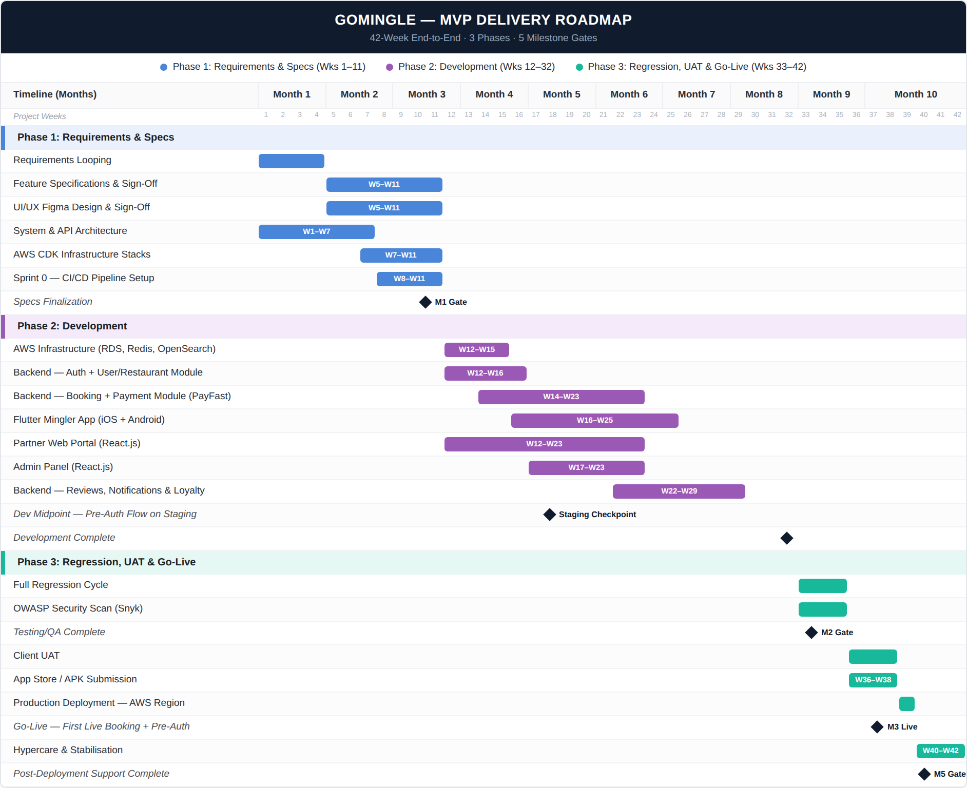

Slide 11
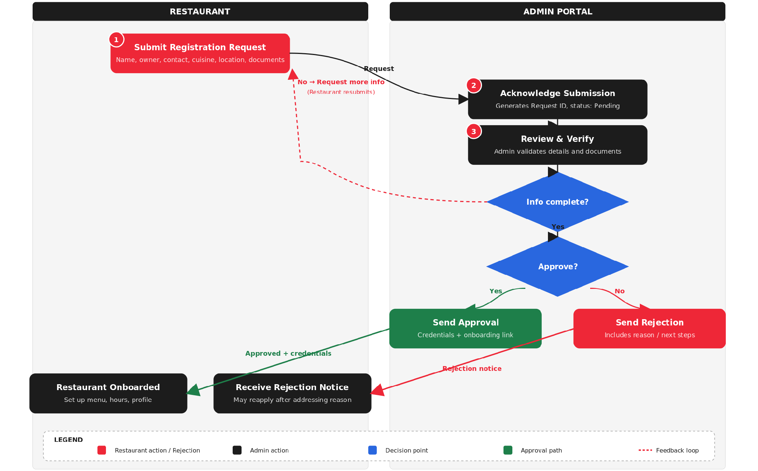
Restaurant Registration Flow

Slide 12
Key Dependencies
Client-side inputs required to hold the 42-week timeline
POC
Branding Guidelines
AWS Account
PayFast/Safepay Account
Apple and Google Play store Accounts
DNS Account (GoDaddy/NameCheap etc)
Amazon SES Account (email notifications)
Google Account for Maps and other services
Apple Developer Account for the Login with Apple ID feature
Legal & Compliance: The team owns legal compliance of the pre-auth penalty mechanic under Pakistan’s consumer law.
Restaurant for UAT
Any slippage on these inputs directly impacts the 42-week end-to-end delivery window.

